Slide 1
Sentiment Analysis Based on
Multi-Channel CNN With Multi-Head
Attention Mechanism

Slide 2
Index
Why this project
What is Sentiment Analysis
What is CNN
Dataset
Software and Hardware Used

Slide 3
Multi-Wavelet Residual Dense Convolutional Neural Network for Image Denoising (Minor Project)
Short Text Sentiment Analysis Based on Multi-Channel CNN With Multi-Head Attention Mechanism
(Major Project)

Slide 4
Why this project?

Slide 5
WHAT IS SENTIMENT ANALYSIS?
Sentiment analysis is a natural language processing (NLP) technique used to determine whether data is positive, negative or neutral.
Sentiment analysis is often performed on textual data to help businesses monitor brand and product sentiment in customer feedback, and understand customer needs.

Slide 6


Slide 7
Simple sentence structure
SUBJECT + VERB(parts of speech) +OBJECT

Slide 8
Word features +
part of speech features
position features
And dependency syntax features
separately to form three new combined features, and inputs convolutional neural network

Slide 9
Vision of this project.
Base paper is using chinese short text.
Implementation in english.
Integration this with social media platforms to help filter or know the reviews in a statistical method.

Slide 10
Convolutional neural network is an important basic model in
deep learning. Since it can automatically extract key features
and has a short training time, it is widely used in the field
of sentiment analysis.

Slide 11
What are Convolutional Neural Networks?
Convolutional Neural Network (ConvNet/CNN) is a Deep Learning algorithm which can take in an input image, assign importance (learnable weights and biases) to various aspects/objects in the image and be able to differentiate one from the other.
It requires less pre-processing when compared to other classification algorithms.
While in primitive methods filters are hand-engineered, with enough training, ConvNets have the ability to learn these filters/characteristics.

Slide 12
Multi-Channel CNN
The three new features are used as the input.
Through three different channels.
So we are using multi-channel convolutional neural network.

Slide 13
Attention Mechanism
Combining the attention mechanism and neural network can often achieve better results.
Divides the sentence into multiple layers and understands it better.

Slide 14
Dataset:
https://www.kaggle.com/vthulisilesibanda/sentiment-analysis/data

Slide 15
Software and Hardware used:
Cpu: Intel i7/(10th gen)
Gpu: Nvidia rtx 2070
Ram: 16gb
Software:Programming lang - Python-3.9
Python libraries used
-Keras,Tensorflow,Numpy,Pandas,OpenCV.

Slide 16
REVIEW 2

Slide 17
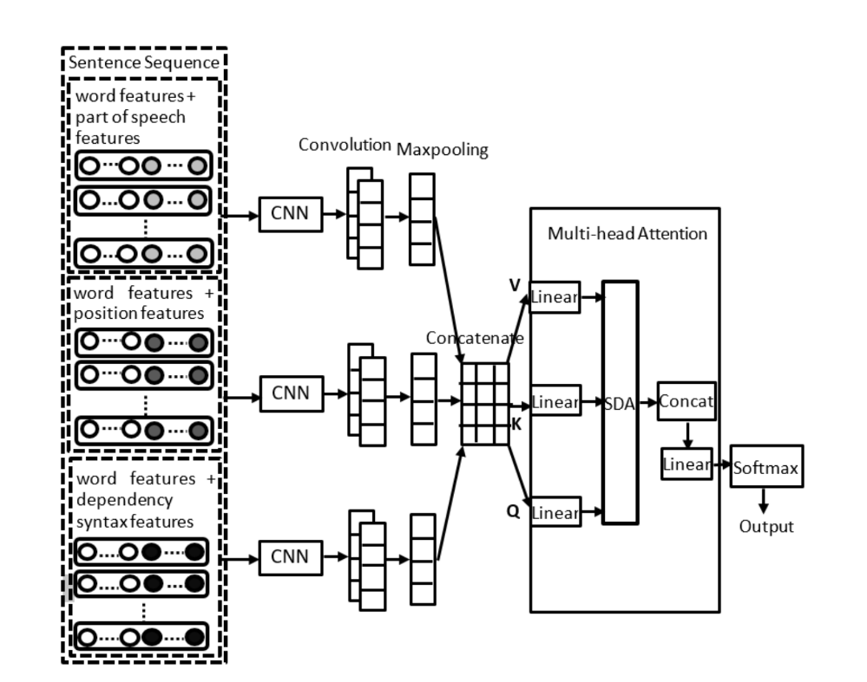
Architecture

Slide 18
Multi-Channel CNN:
A multi-channel convolutional neural network for document classification involves using multiple versions of the standard model with different sized kernels. This allows the document to be processed at different resolutions or different n-grams (groups of words) at a time, whilst the model learns how to best integrate these interpretations.
Convolutional Neural Network (CNN) can effectively extract localized structural information. Here we used multiple windows and multiple convolution kernels on different channels to perform convolution operations and to extract richer feature information.

Slide 19
Attention Mechanism
Combining the attention mechanism and neural network can often achieve better results.
Divides the sentence into multiple layers and understands it better.

Slide 20
Project Flow
->Importing necessary Libraries
->Importing Dataset
->Data Cleaning
->Train and Test split
->Model Creation
->Training the model
->Plotting the results

Slide 21
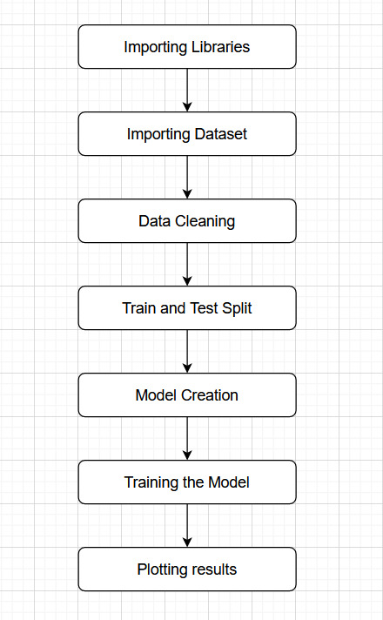

Slide 22
Required Libraries
Keras : Keras is a powerful and easy-to-use free open source Python library for developing and evaluating deep learning models.
Sklearn : Scikit-learn (Sklearn) is the most useful and robust library for machine learning in Python. It provides a selection of efficient tools for machine learning and statistical modeling.
Pandas : Pandas is a predominantly used python data analysis library. It provides many functions and methods to expedite the data analysis process.
NLTK : NLTK is a standard python library with prebuilt functions and utilities for the ease of use and implementation.
Collections: Collections in python are basically container data types, namely lists, sets, tuples, dictionary.

Slide 23
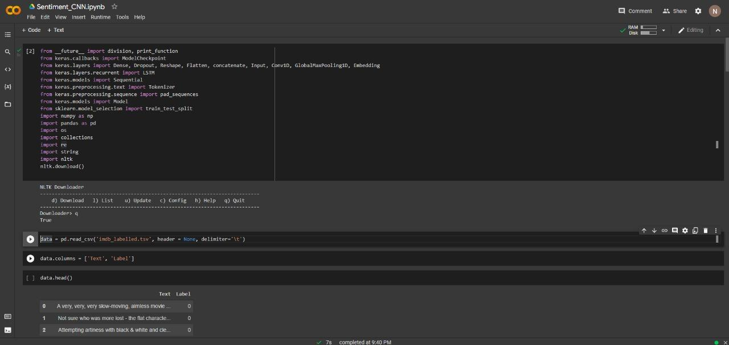
Partial Code:

Slide 24
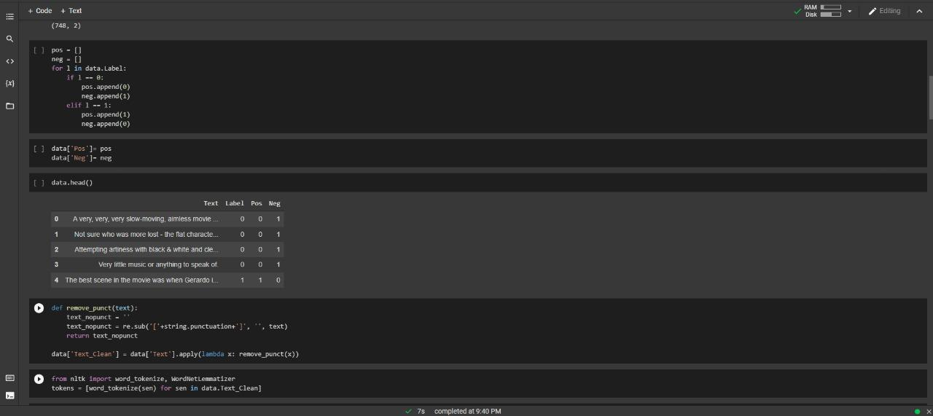

Slide 25
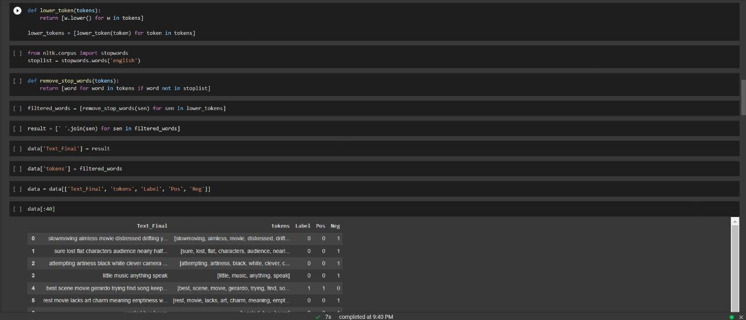

Slide 26
THANK YOU

